Slide 1
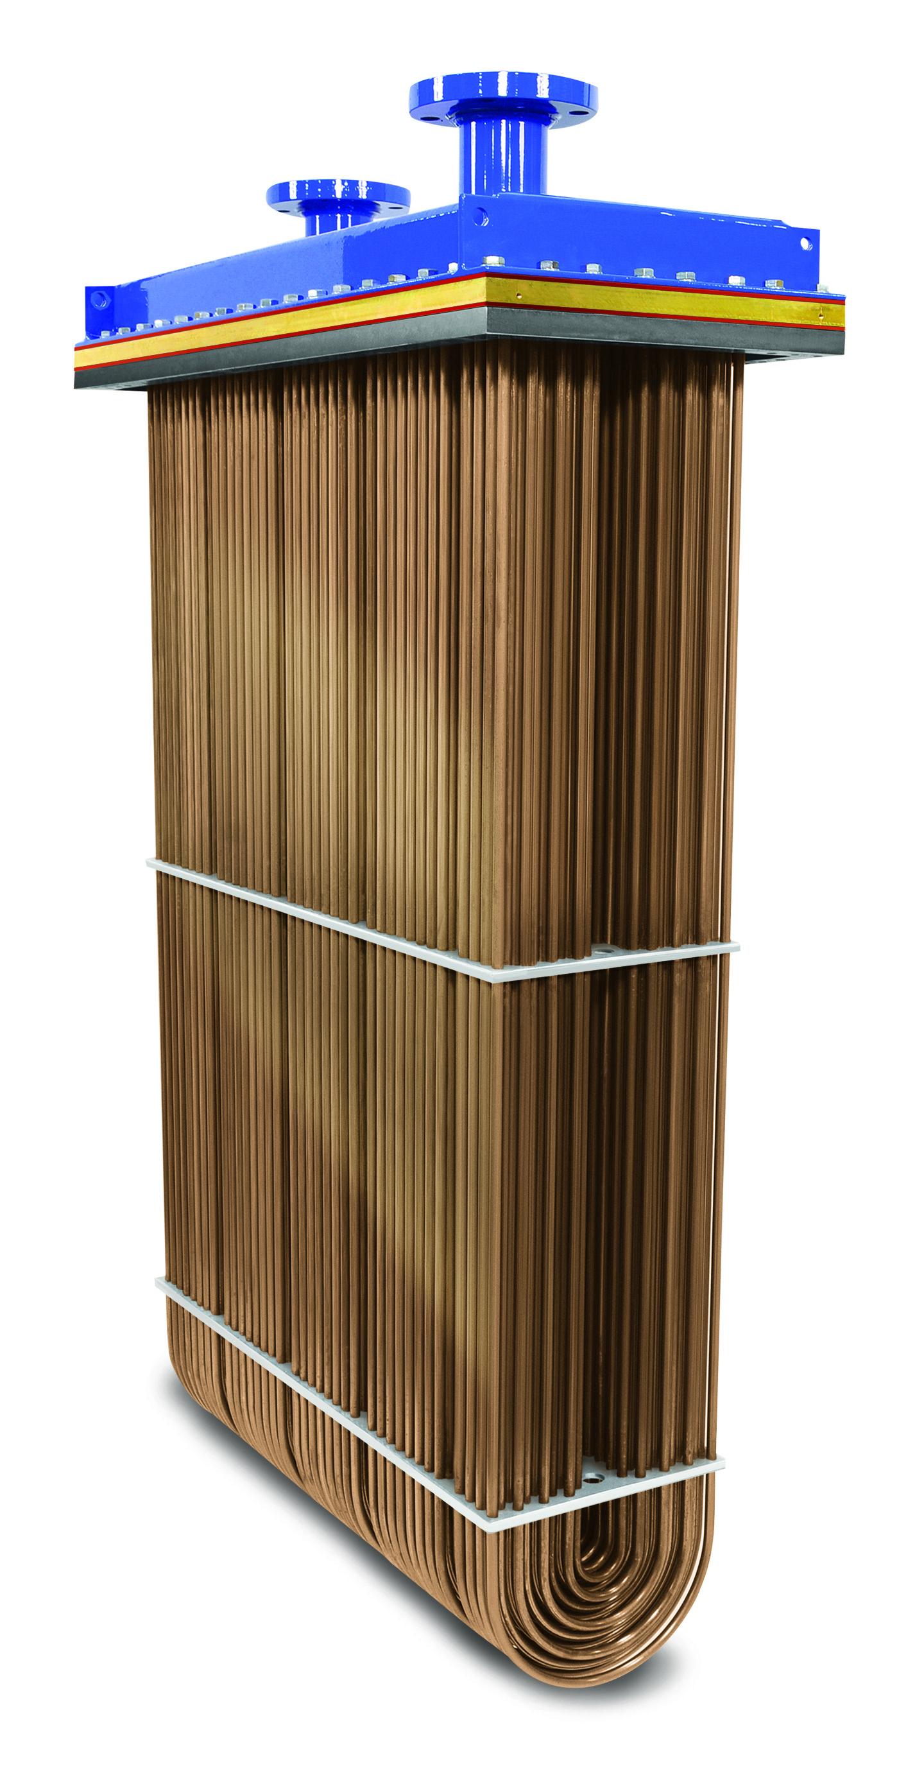
WEKA
Boxcoolers
R.W. Fernstrum & Company

Slide 2
By the end of this session, you will:
Learn about the WEKA Boxcooler and understand the value
Market Review
Technology
Design
Installation
Warranty Registration
Maintenance
Competitor Overview

Slide 3
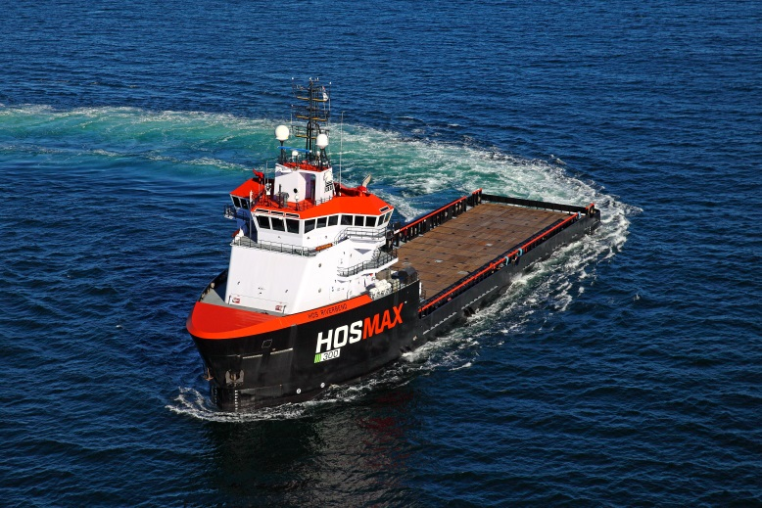
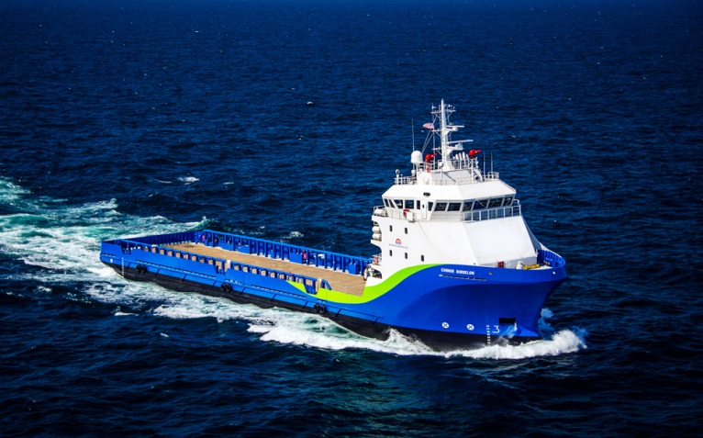
Engineered to Cool
Applications
Air conditioning units
Bow thrusters
Compressors
Electrical equipment
Generator sets
Hydraulics
Propulsion & auxiliary engines
Pumps
Reduction gears
Type of Vessel
Barges
Cargo ships
Carriers
Dredgers
Ferries
Fishing vessels
Ice breakers
Supply vessels
Tankers
Tugs

Slide 4
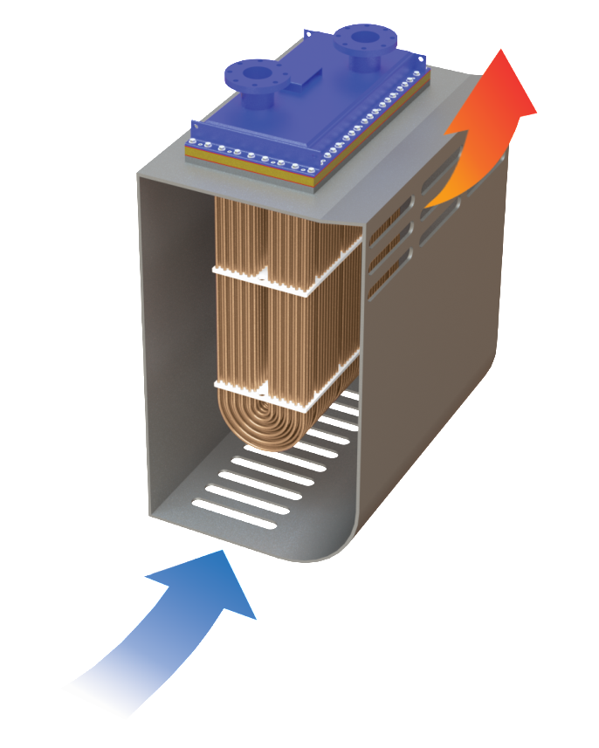
Boxcooler Technology
Exploits Natural Convection
Position of the inlet and outlet slots direct the natural flow of seawater through the sea chest and across the boxcooler tubes.
Reverse Flow
When vessel is underway.
Outlet Slots
Sea Chest
Inlet Slots

Slide 5
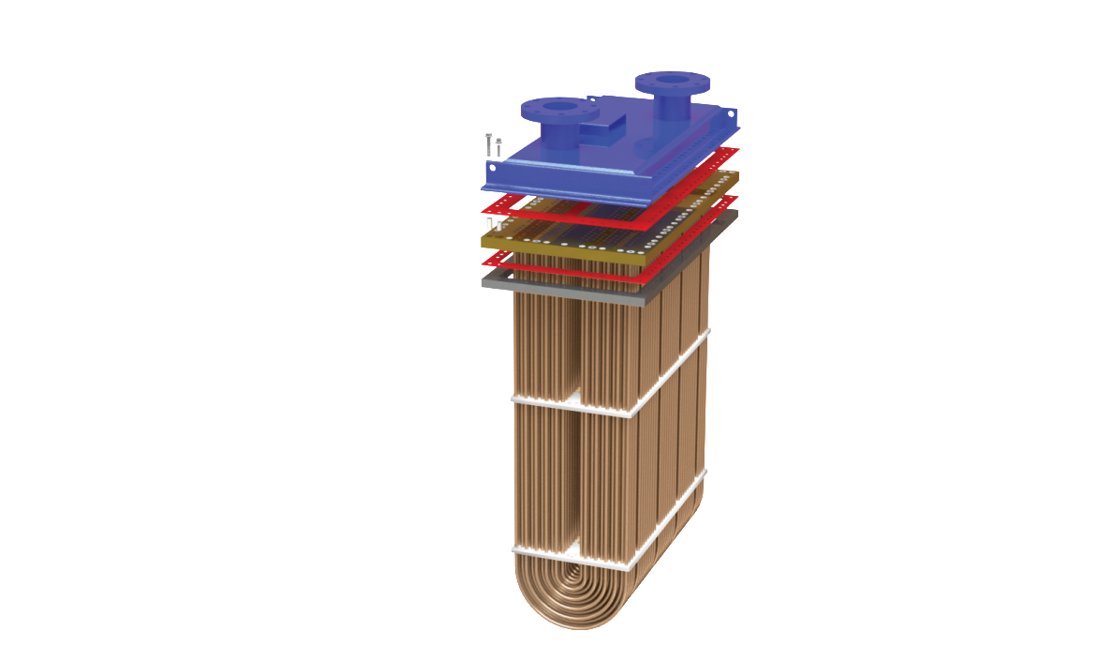
Exploded View of the WEKA Boxcooler
Mounting Frame
Once the Mounting Frame is welded to the top of the sea chest, the frame creates the water tight seal

Slide 6
Design Features
Exploded View of the WEKA Boxcooler
Complete isolation from the hull during installation and operation
Bonnet Gasket
Insulators
Ring Gasket
Support Plates
TiVor Hot* Support plates help protect the tubes from the hull’s vibrations
* 12 mm thick Teflon

Slide 7
Design Features
Constructed using uncoated 90/10 Copper Nickel tubing
Uncoated 90/10 Copper Nickel Tubes
Coated Aluminum Brass Tubes
Comparison of Boxcooler Material
Based on a 6 week test

Slide 8
“Copper alloys possess an inherent natural resistance to biofouling. You can see that in these photos which are the result of a 3-month study of several metals in seawater. Clearly, the 90/10 Cu-Ni alloy is resisting fouling from algae mussels, etc. For clarification, the biofouling resistance of copper alloys is due to the copper in the protective oxide film; it is not from the leaching of copper ions.” (Olin Brass)
Photos are from The Interrelation Of Corrosion and Fouling Of Metals In Seawater, K.D. Efird, NACE Corrosion/75
Based on a 6 week test

Slide 9
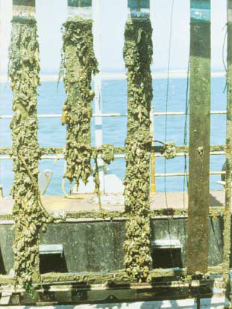
“FIGURE 4. Exposure Panels. Panels after 12 months exposure at Langstone Harbour, UK. Left to right-Steel, 90-10 copper-nickel sheathed steel, copper-nickel; all protected with aluminum anodes attached. Far right unprotected copper-nickel. There is no fouling on the unprotected copper-nickel panel.
FIGURE 1. Effect of cathodic protection on anti-fouling of 9010 CuNi
Hence 9010 CuNi tubes would be normally kept electrically isolated form the ships hull, to prevent the CuNi picking up cathodic protection current from the ships cathodic protection system.”
Photo from C A Powell, Preventing Biofouling with Copper-Nickel, Copper Development Association Publication 157 October 2002
CA Powell and H T Michels, Copper-Nickel alloys for seawater corrosion resistance and antifouling, a state of the art review, paper no 00627, NACE Corrosion 2000, Orlando, FL, Mar-2000.
Based on a 6 week test

Slide 10
Design Features
WEKA GuardTM
WEKA ProtectorTM Type T
*Recommended replacement every 5 years
Helps minimize potential damage to the units and hull from stray electrical currents and galvanic corrosion

Slide 11
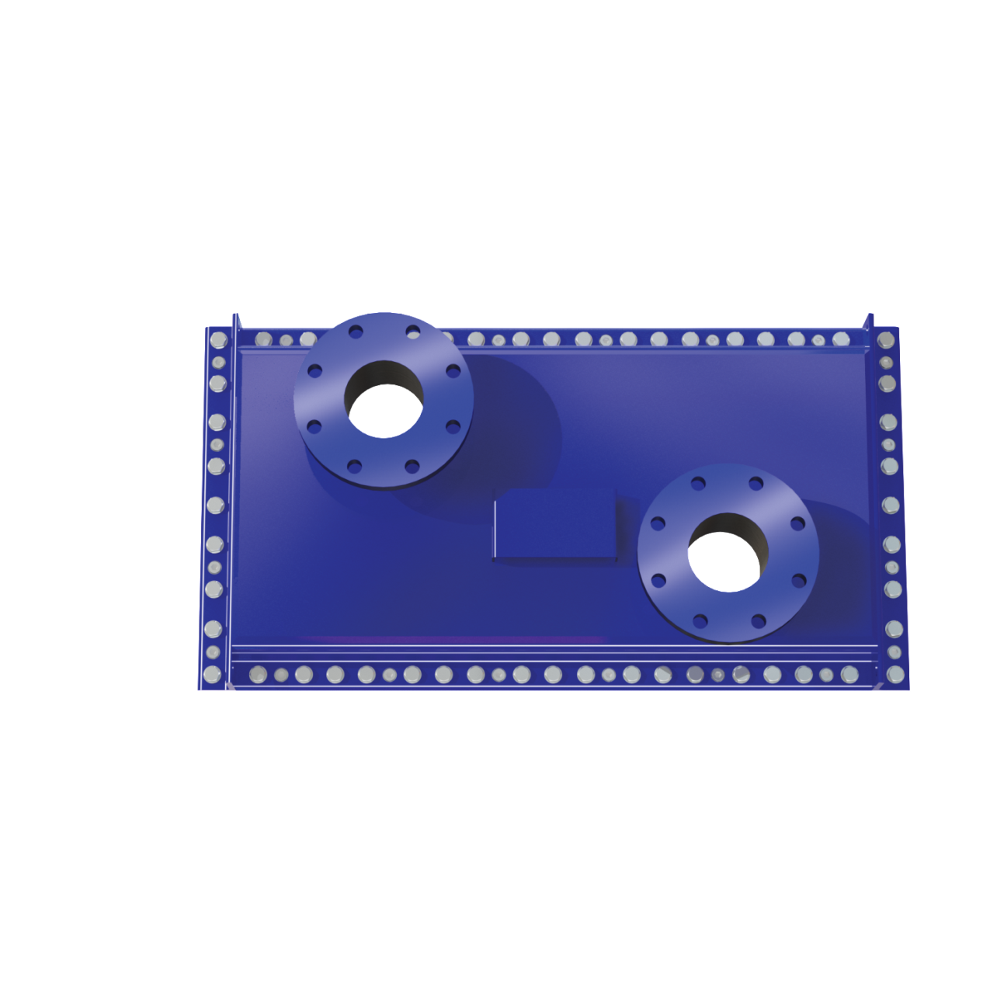
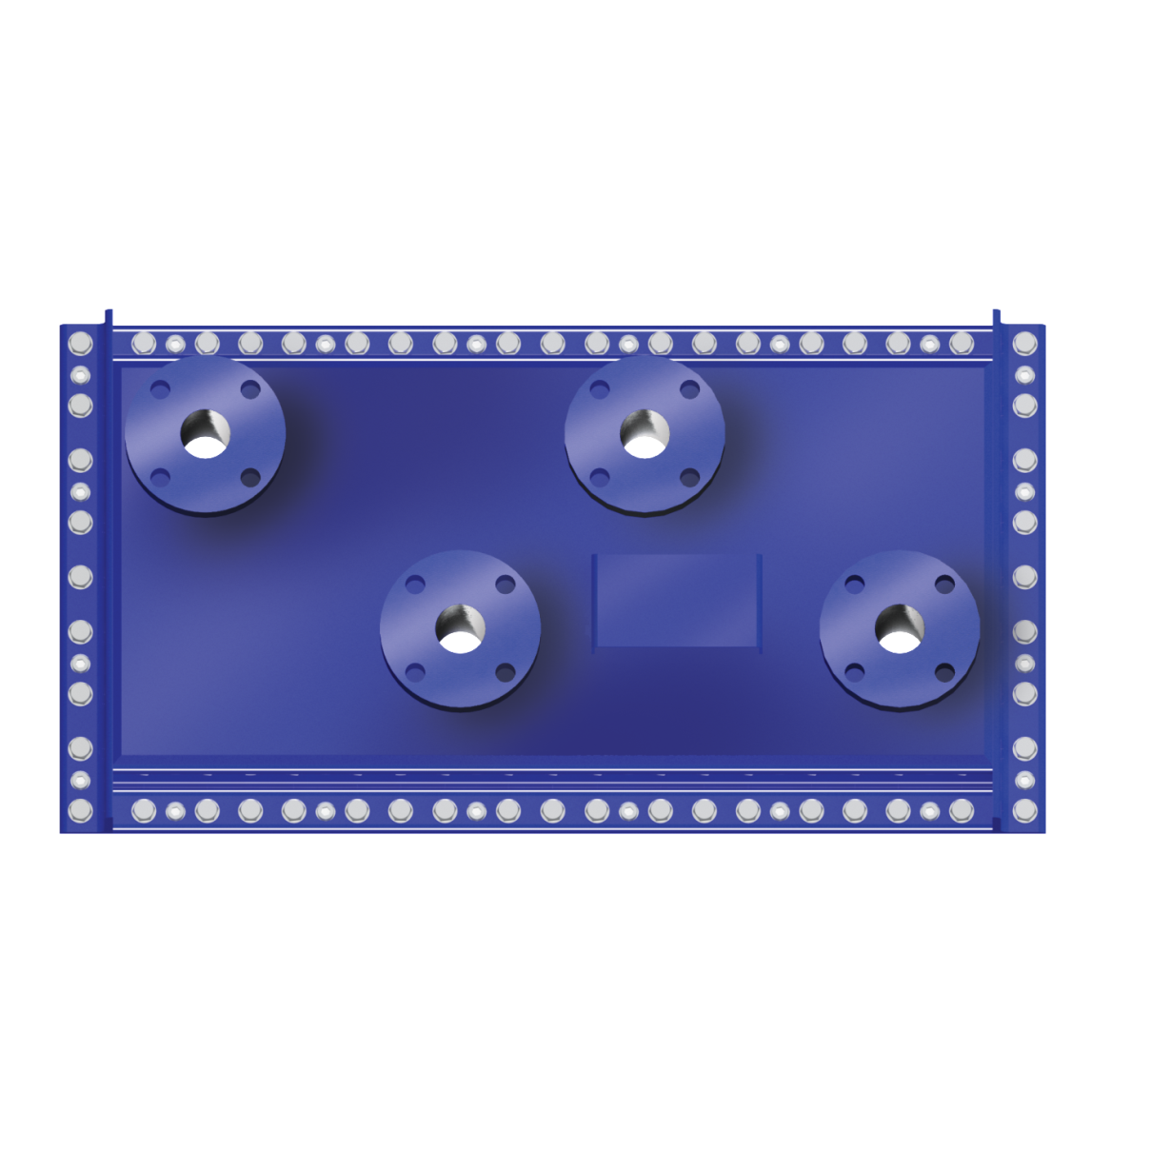
Design Features
Designed to support single or multiple heat sources on one unit
One Circuit
Single heat source
Multiple Circuits
More than one heat source

Slide 12
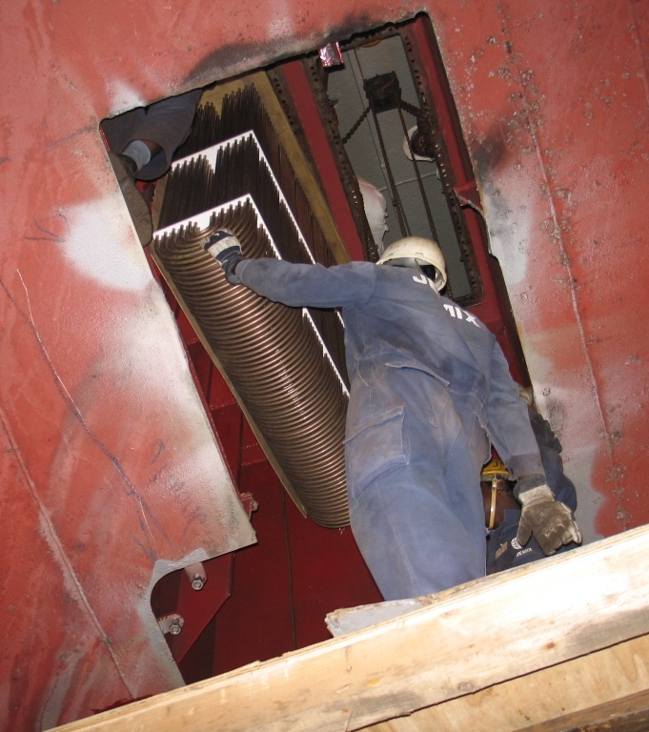
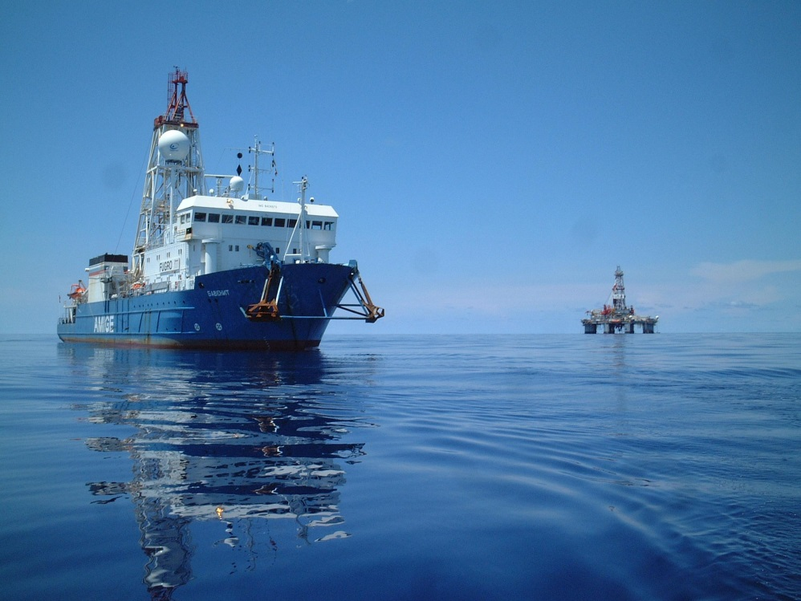
Design Features
Bottom Mounted WEKA Boxcoolers
Repowering or additional equipment requires cooling
Meets DNV Requirements

Slide 13
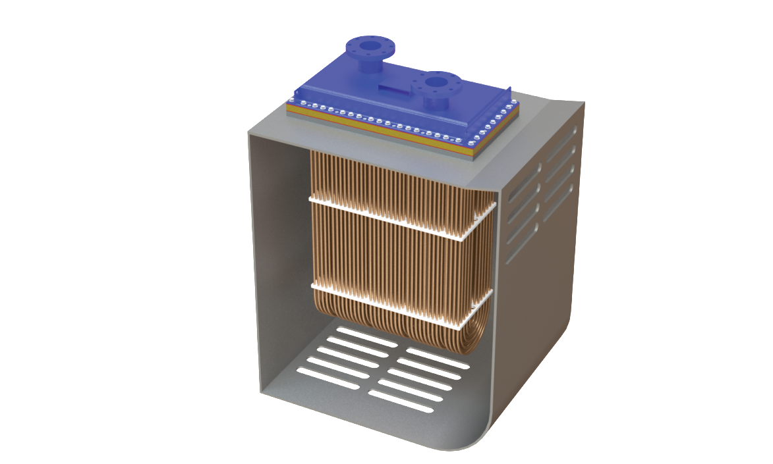
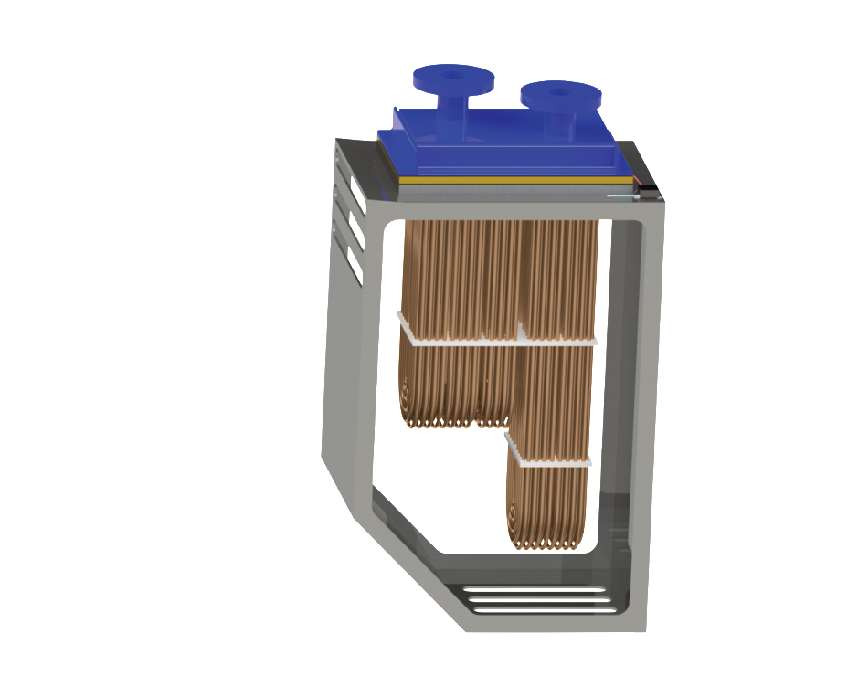
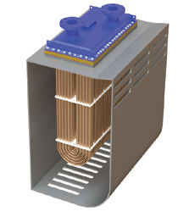
Installation
Athwartship Installation
Longitudinal Installation
Stepped Boxcooler

Slide 14
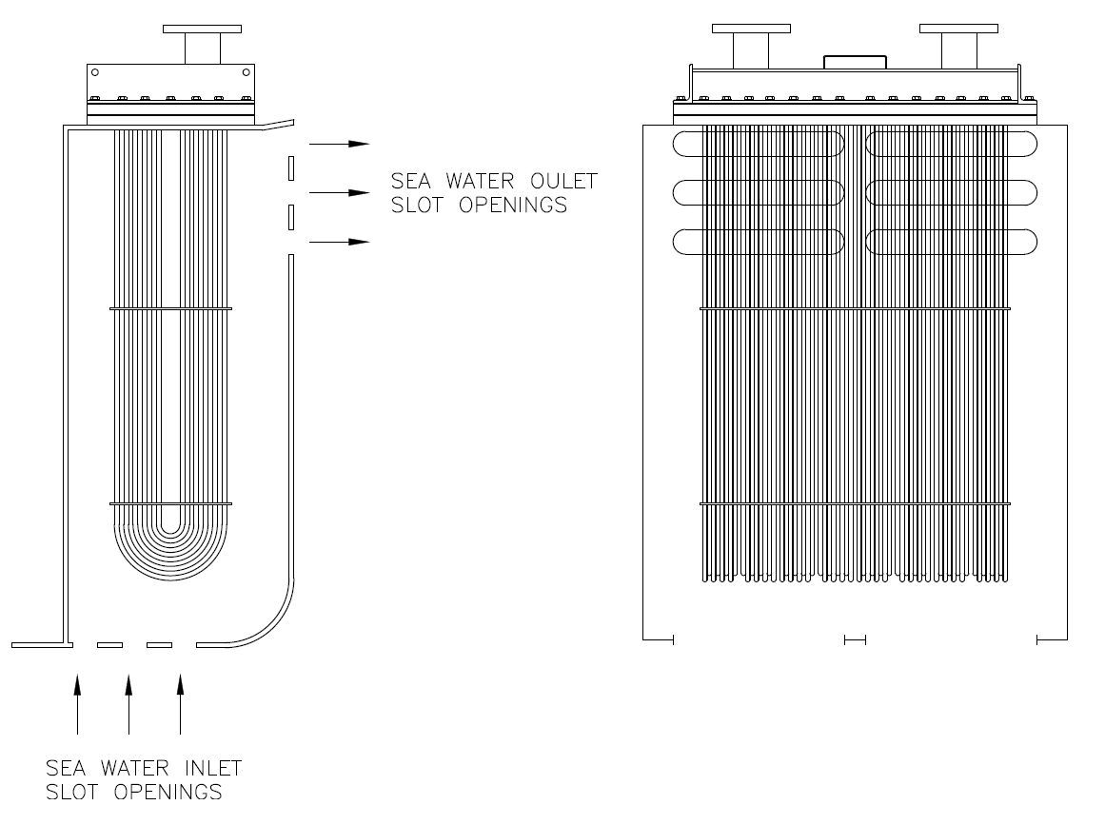
Sea Chest (Correct Slot Openings)

Slide 15
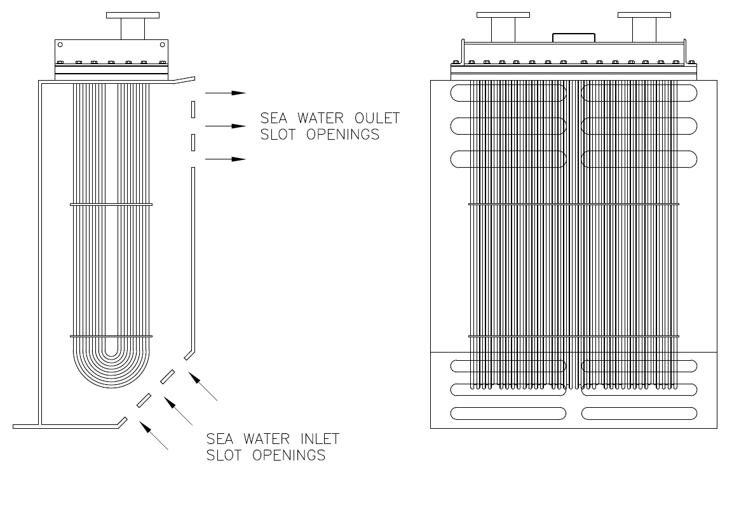
Sea Chest (Incorrect Slot Openings)

Slide 16
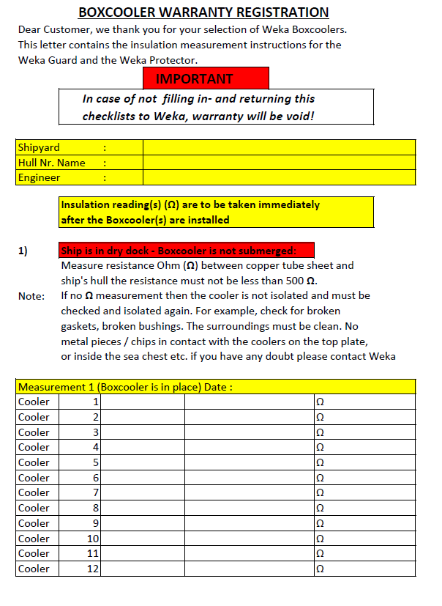
Warranty Registration
APPENDIX C

Slide 17
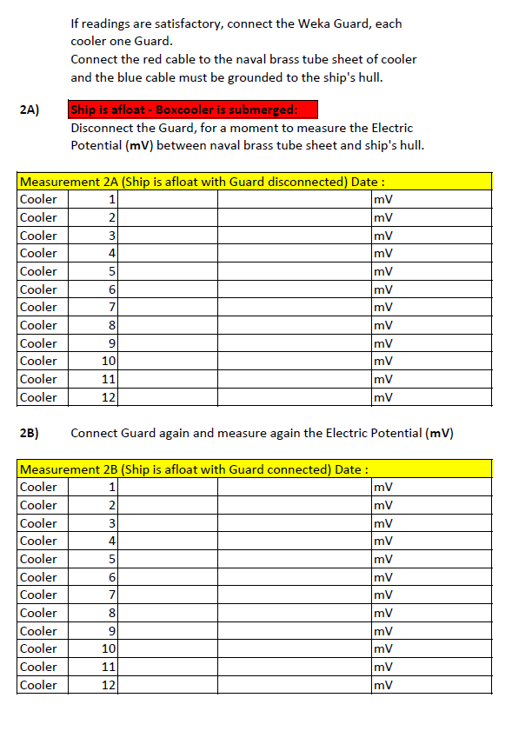
Warranty Registration
APPENDIX C

Slide 18
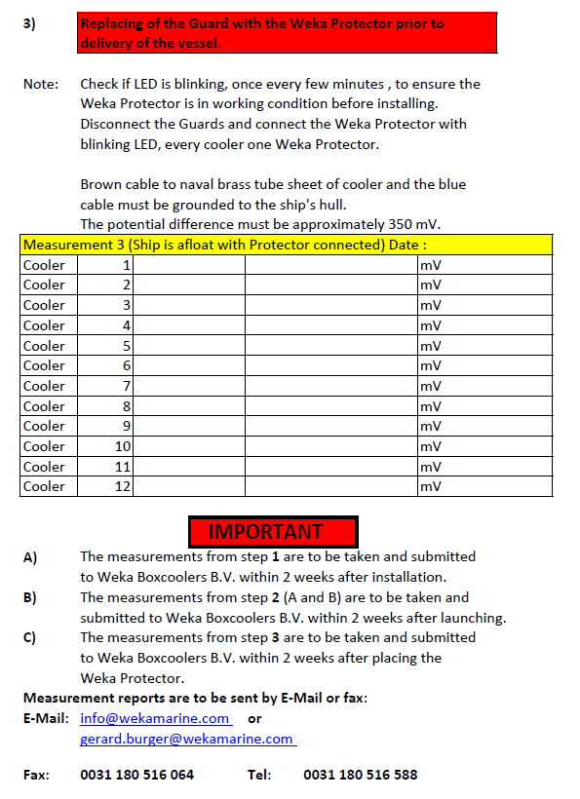
Warranty Registration
APPENDIX C

Slide 19
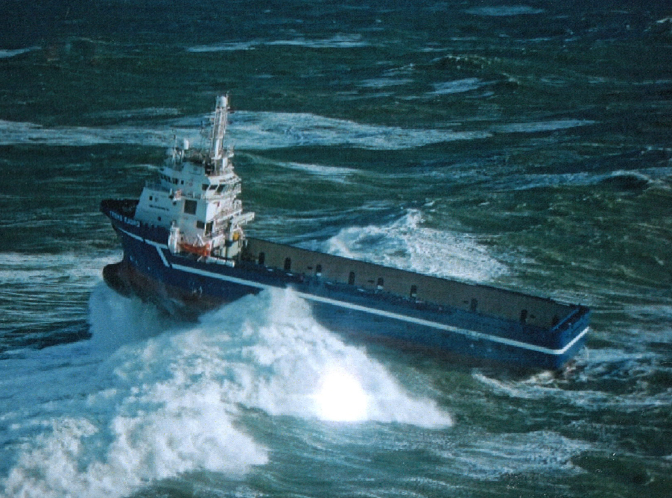

Slide 20
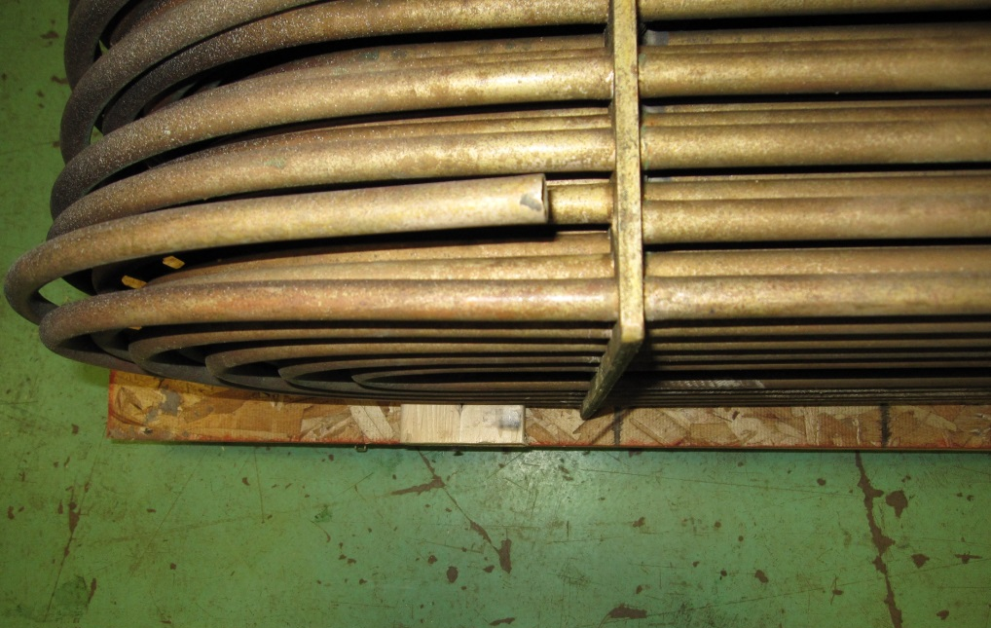
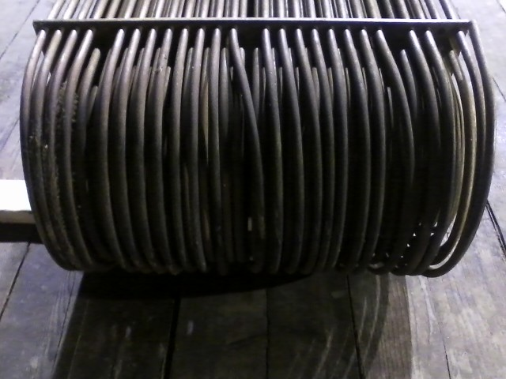
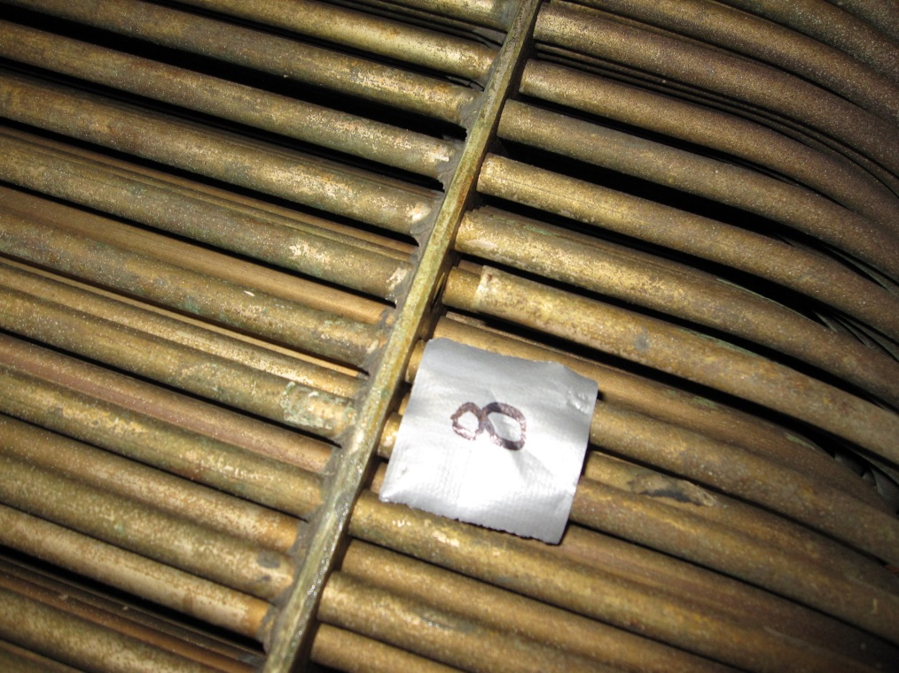
Maintenance
WEKA Protector
Brass Plugs

Slide 21
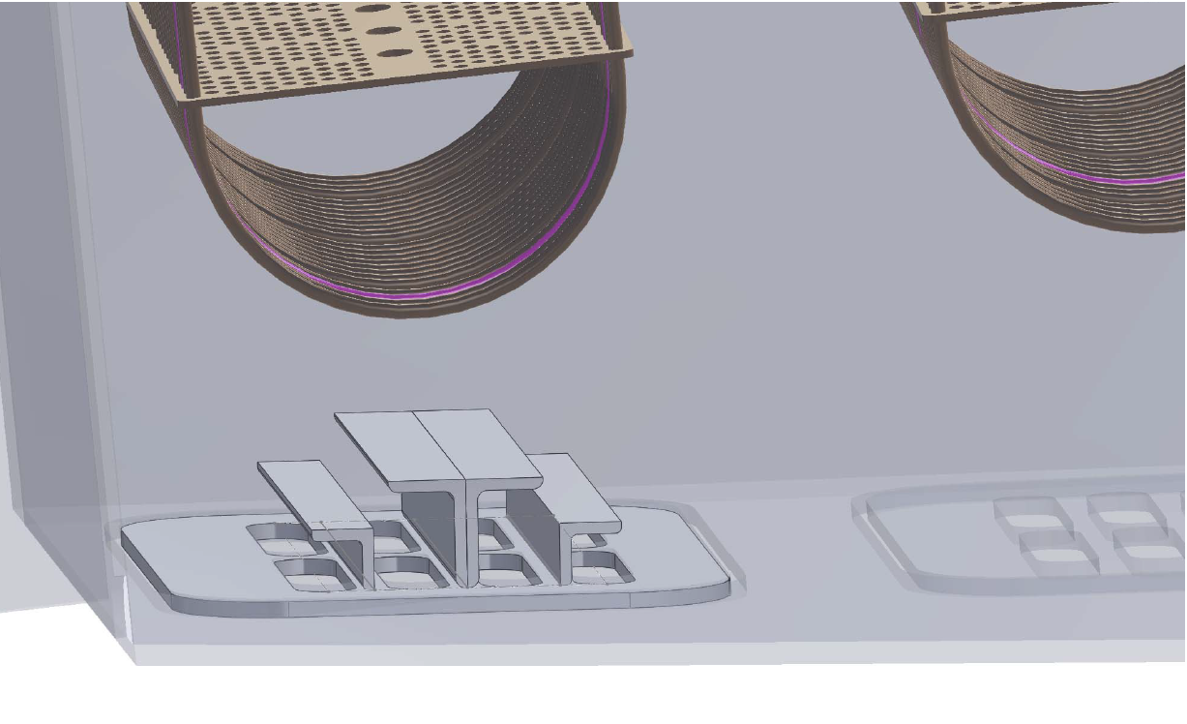

Slide 22
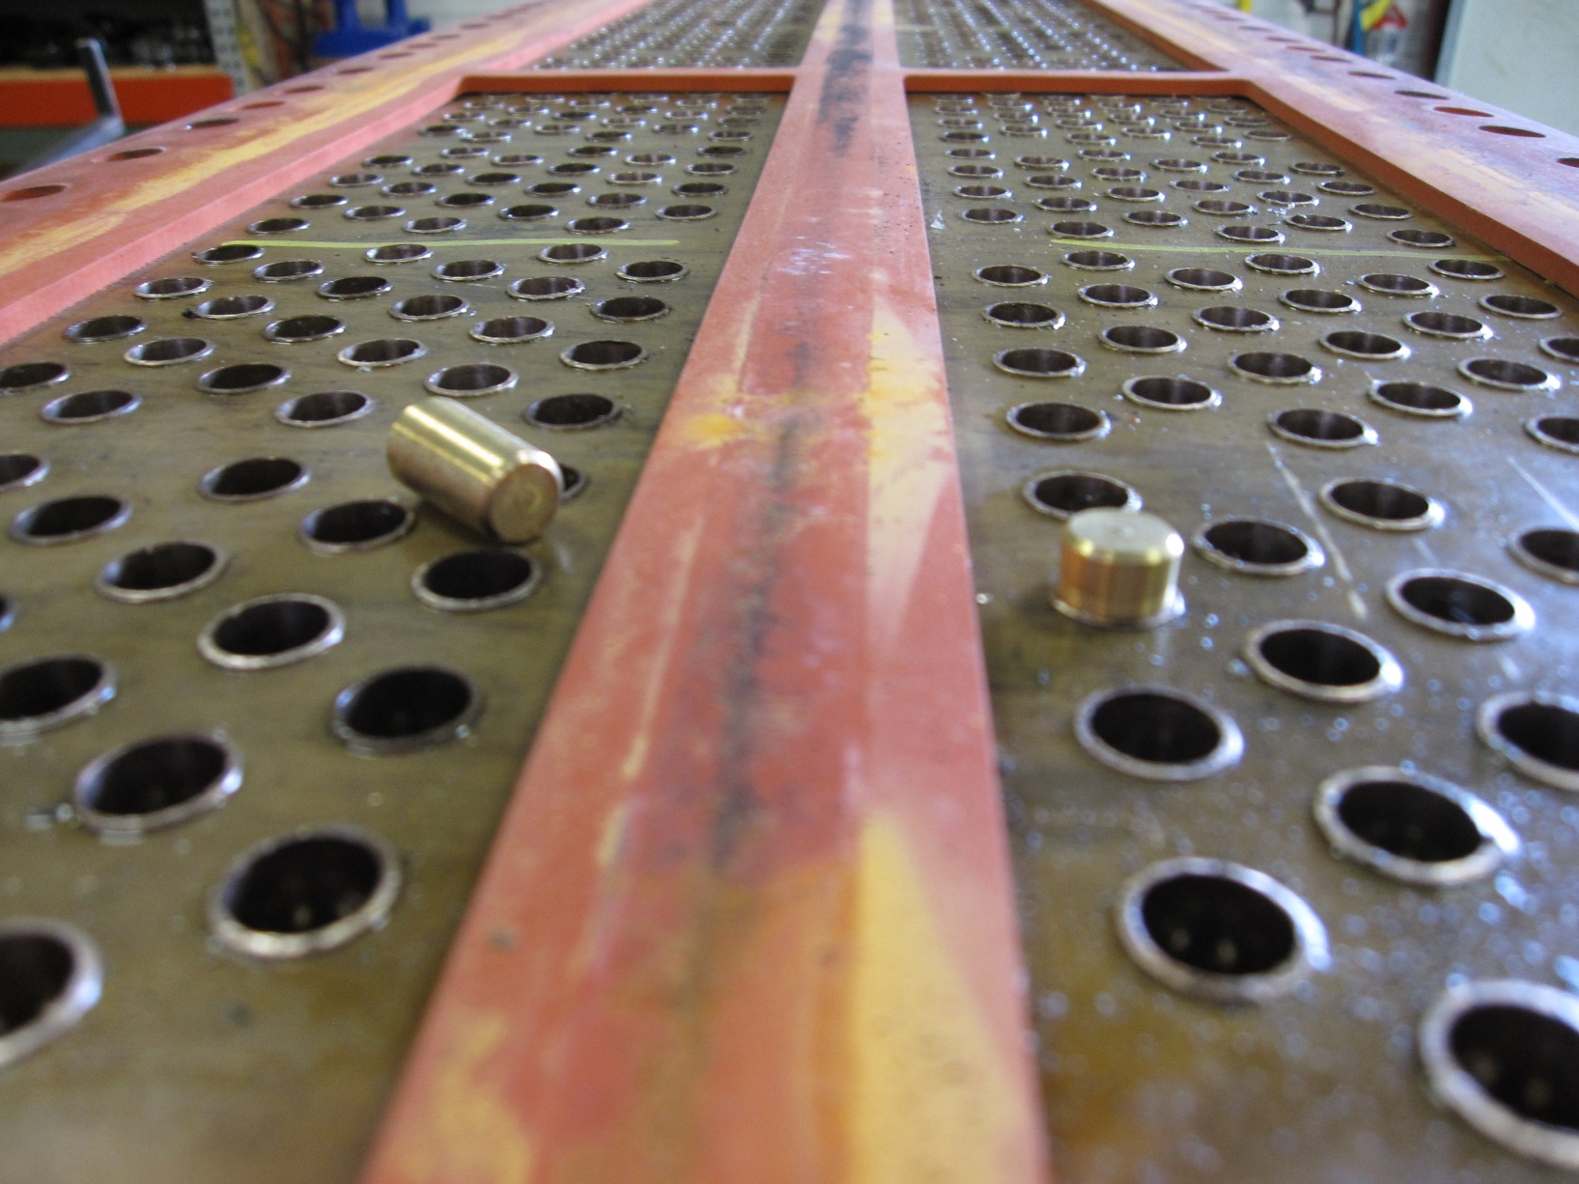
Brass Plugs (Permanent Repair)

Slide 23
Competitors
Four main competitors
Duramax Boxcoolers, Klima
Bloksma, GEA Heat Exchangers – Triton
NRF Box Coolers
Sperre Rack Cooler
Competitors vs WEKA Boxcooler (main differences)
Coated Aluminum Brass Tubes
ICAF System
Maintenance

Slide 24
ICAF (Impressed Current Anti Fouling System)
Typical Anode Requirement is 0.6 kg/sq. m Cooling Surface per Year
ICAF System for Typical PSV:
4 x 1800 kW Diesel Gen – Sets, Auxiliary Cooling for Converters, Transformers, DC Motors, etc. = 422 sq. m of Boxcooler Tubes
Total of 422 sq. m x 0.6 kg/year = 253.2 kg of Copper Anodes Required per Year
Total of 253.2 x 5 = 1266 kg (over 1 metric ton) of Copper Anodes Required for 5 Year Docking Schedule

Slide 25
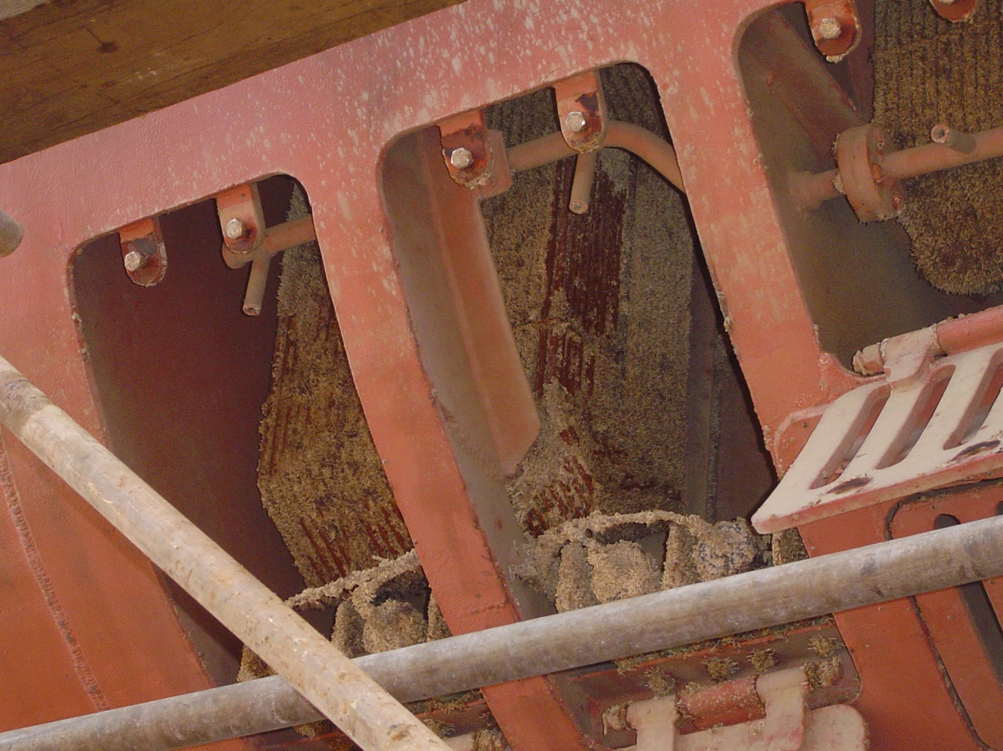
Coated Boxcoolers on Singapore Tugs

Slide 26
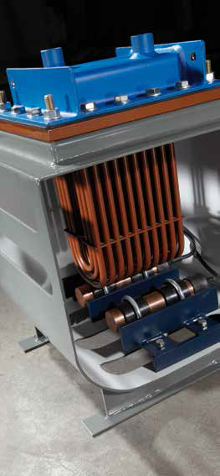
ICAF (Impressed Current Anti Fouling System)
Remember:
ICAF Systems do not work in fresh water
The copper anodes do not have an electrolyte to dissolve

Slide 27
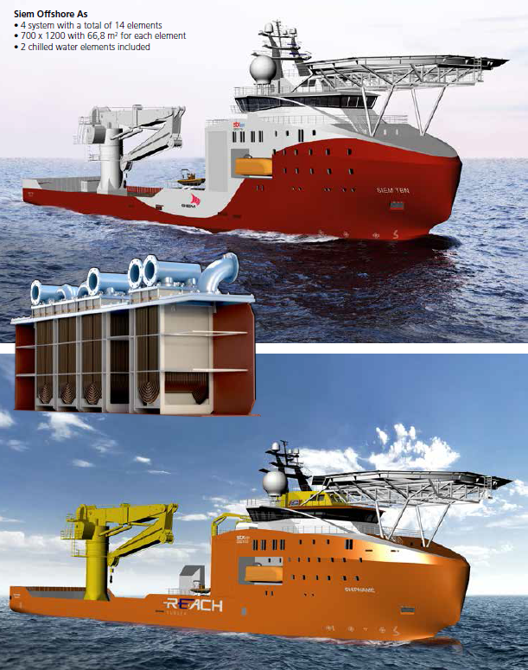
Sperre Rack Cooler

Slide 28
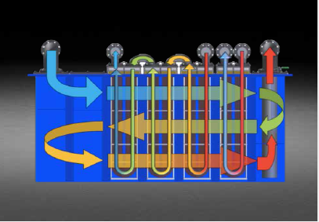
Sperre Rack Cooler

Slide 29
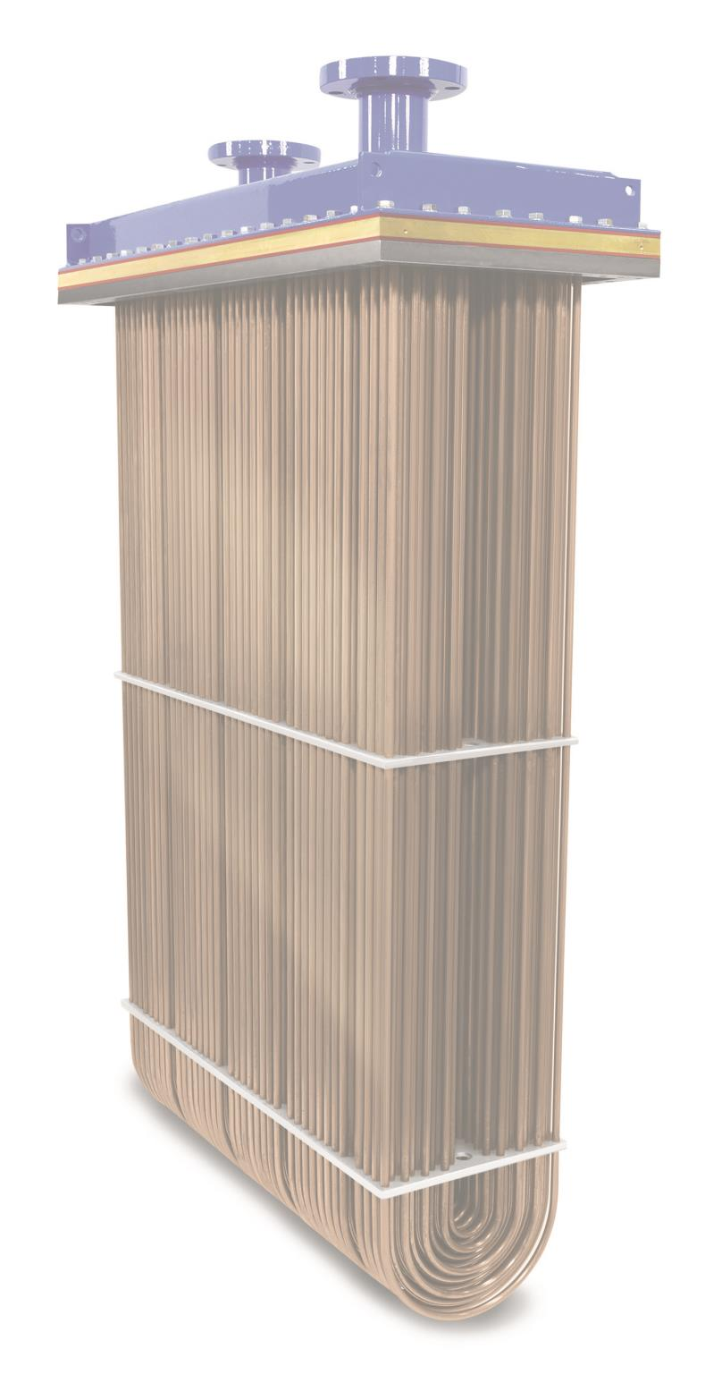
Selling WEKA Boxcoolers
Closed Loop Cooling System
Sea water does NOT enter the hull
Manufactured exclusively with 90/10 copper nickel tubes
Due to Natural Anti Fouling, an ICAF system is not required
Routine maintenance does not require dry docking
The exclusive bolt hole pattern allows the bonnet to be removed inside the vessel without sea water seeping into the vessel

Slide 30
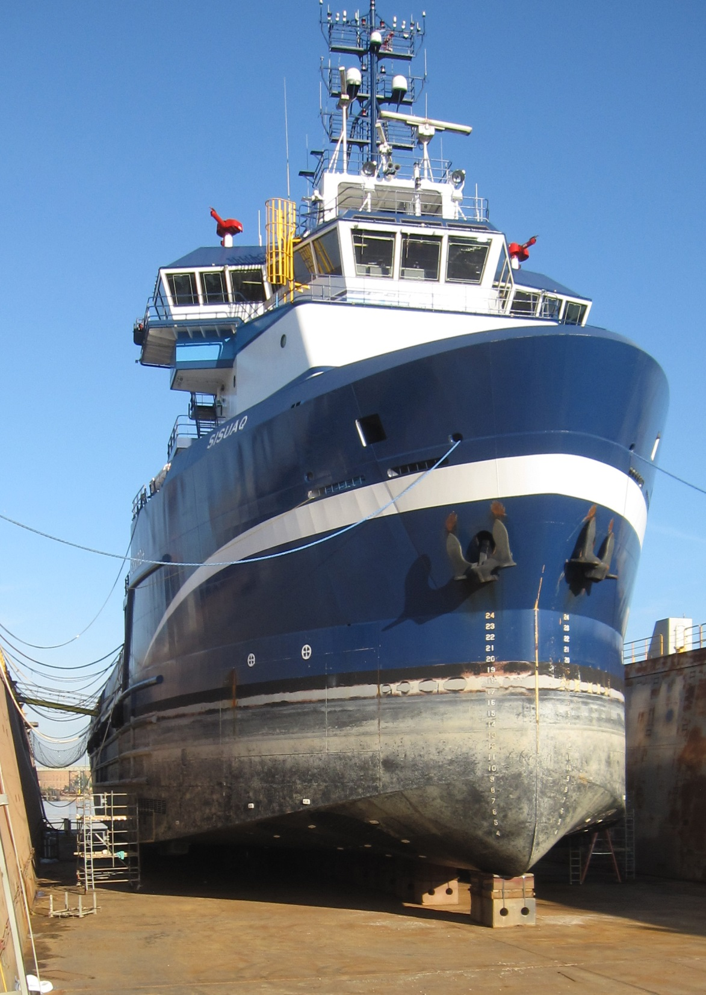
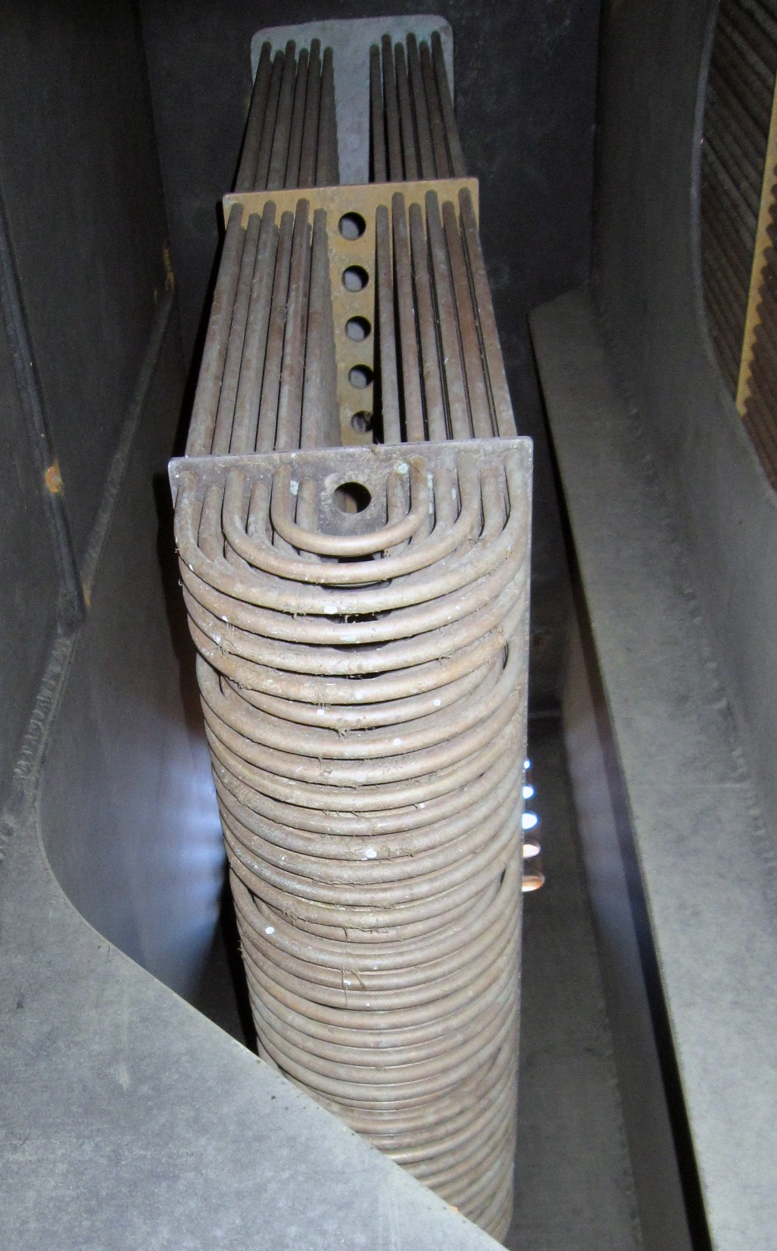
Sisuaq - Harvey Gulf

